Slide 1
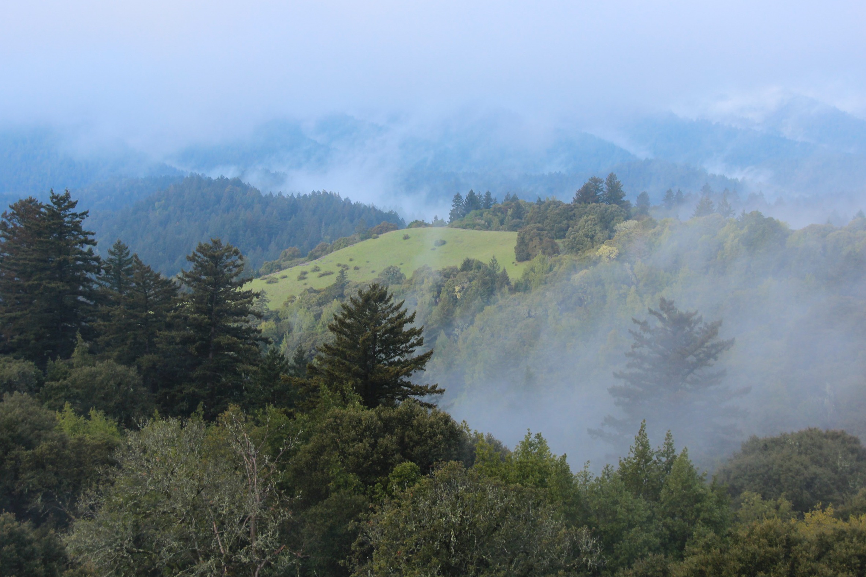
Climate Action at a Public Land Agency
Kirk Lenington, Natural Resources Manager
Hayley Edmonston, Climate Resiliency Fellow

Slide 2
Outline
Introduction
Climate Program Overview
Resilience and Adaptation
Carbon Sequestration
Mitigation (GHG Inventory + Climate Action Plan)
Key Strategies to Reduce Your Organization’s Emissions
Resources

Slide 3
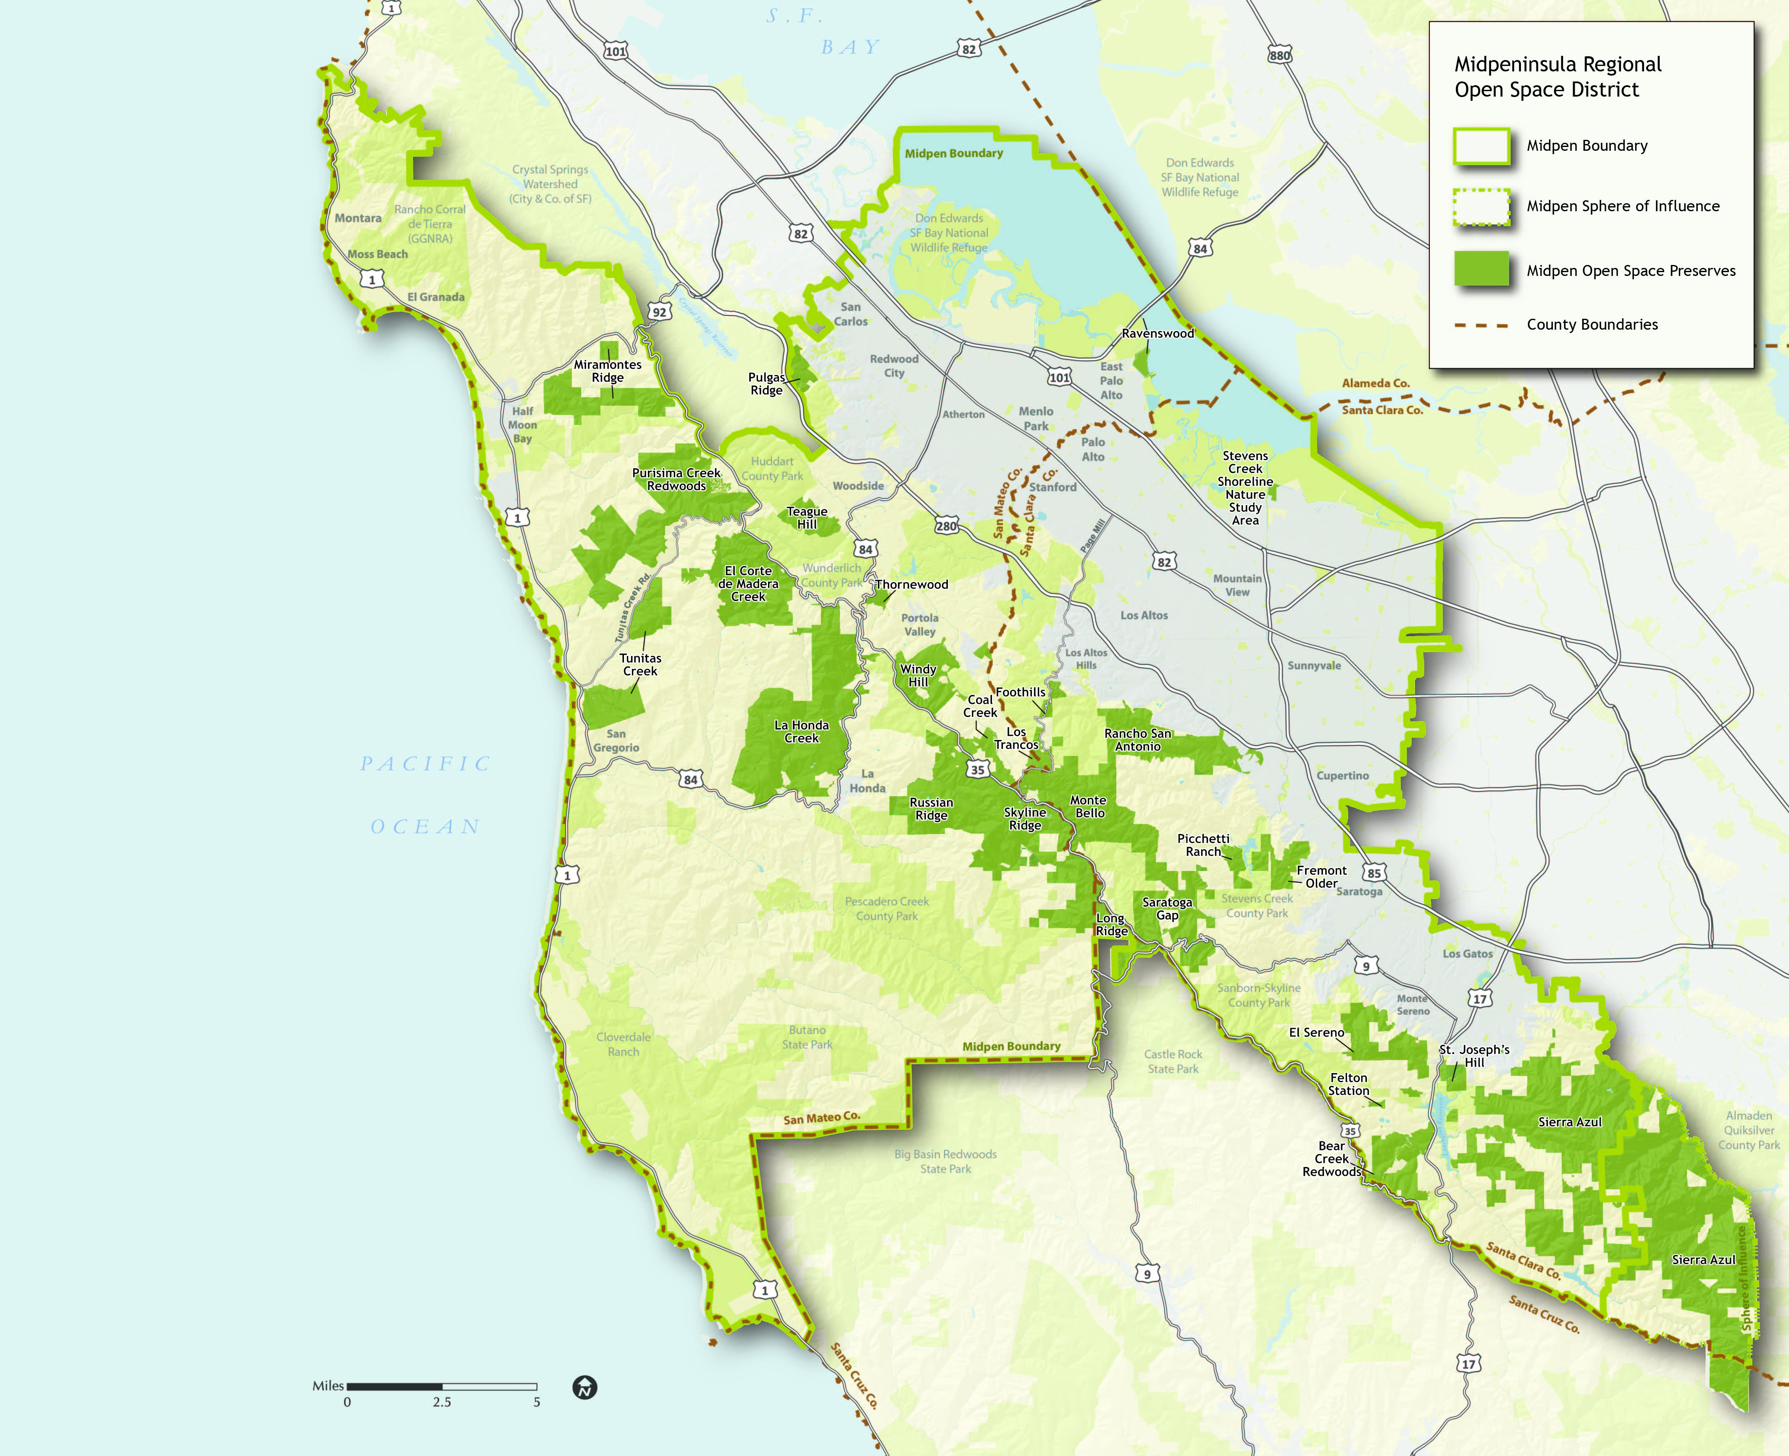
District At-a-Glance
Presentation Outline

Slide 4
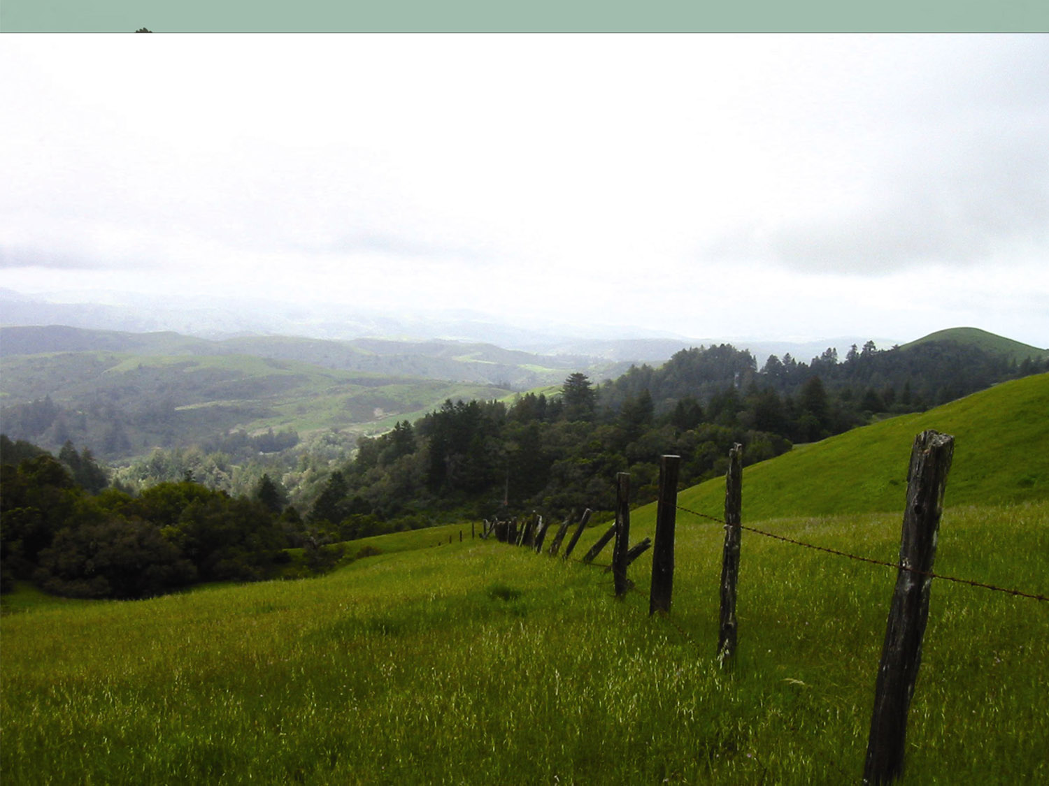
Midpeninsula Regional Open Space District
The District's mission is to acquire and preserve a regional greenbelt of open space land in perpetuity; protect and restore the natural environment; and provide opportunities for ecologically sensitive public enjoyment and education
Frank Crossman

Slide 5
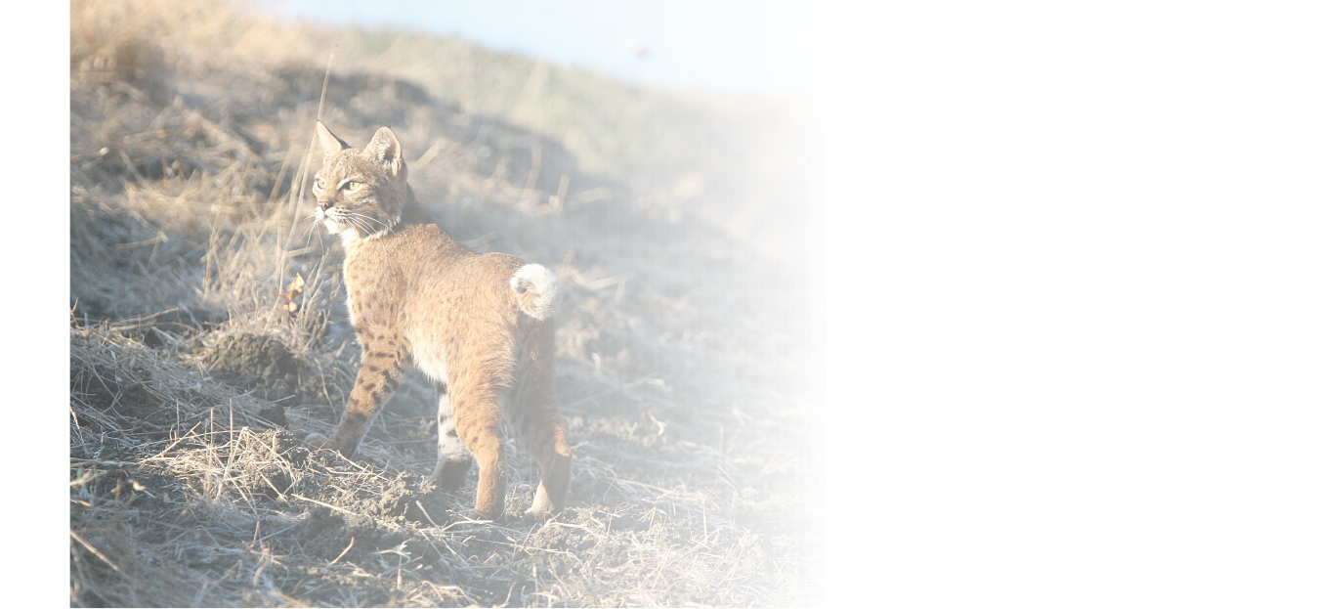
Climate Program Overview
Mitigation
Resilience and Adaptation
Sequestration
Vulnerability Assessment
Assessment: Permanent Carbon Storage and Ongoing Carbon Sequestration
Greenhouse Gas Inventory
Climate Action Plan
Scenario Planning
Sensitive Habitats
Land Management to Increase Carbon Sequestration
Wildland Fire Management

Slide 6
Areas with Cooler Microclimates
Cool, Moist areas of Low Solar Radiation
Ponds. Lakes, Wetlands Streams
Midpen Boundary
Midpen Sphere of Influence Midpen Open Space Preserves

Slide 7
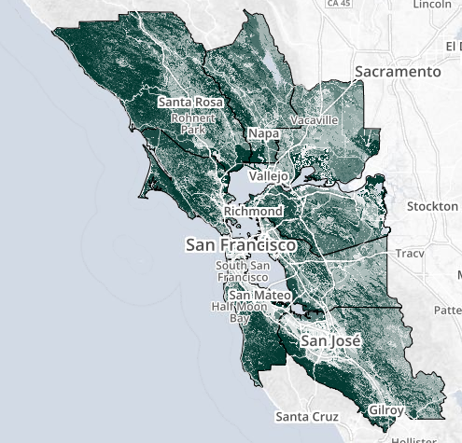
Carbon Sequestration
Presentation Outline
Terminology
Annual carbon sequestration: process of removing CO2 from atmosphere
Permanent carbon storage: reservoir of carbon stored in plant biomass and soils
Metric ton of CO2 equivalent (MTCO2e): standard unit for greenhouse gases
Assessment Methodology
LANDFIRE vegetation layers with biomass and carbon (from CA Air Resources Board)
gSSURGO soil carbon data (from Natural Resources Conservation Service)
Conservative estimate – annual sequestration only includes forest canopy
Assessment by Midpen GIS Analyst Nathan Greig

Slide 8
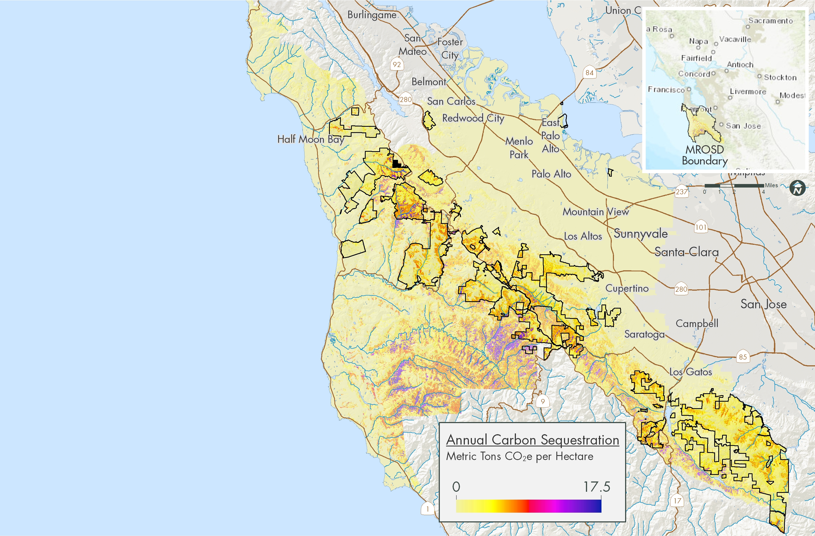
Carbon Sequestration Assessment
Presentation Outline
Annual Carbon Sequestration:
61,000 MTCO2e
Equivalent to emissions of 13,000 cars for one year
Think of as offset emissions

Slide 9
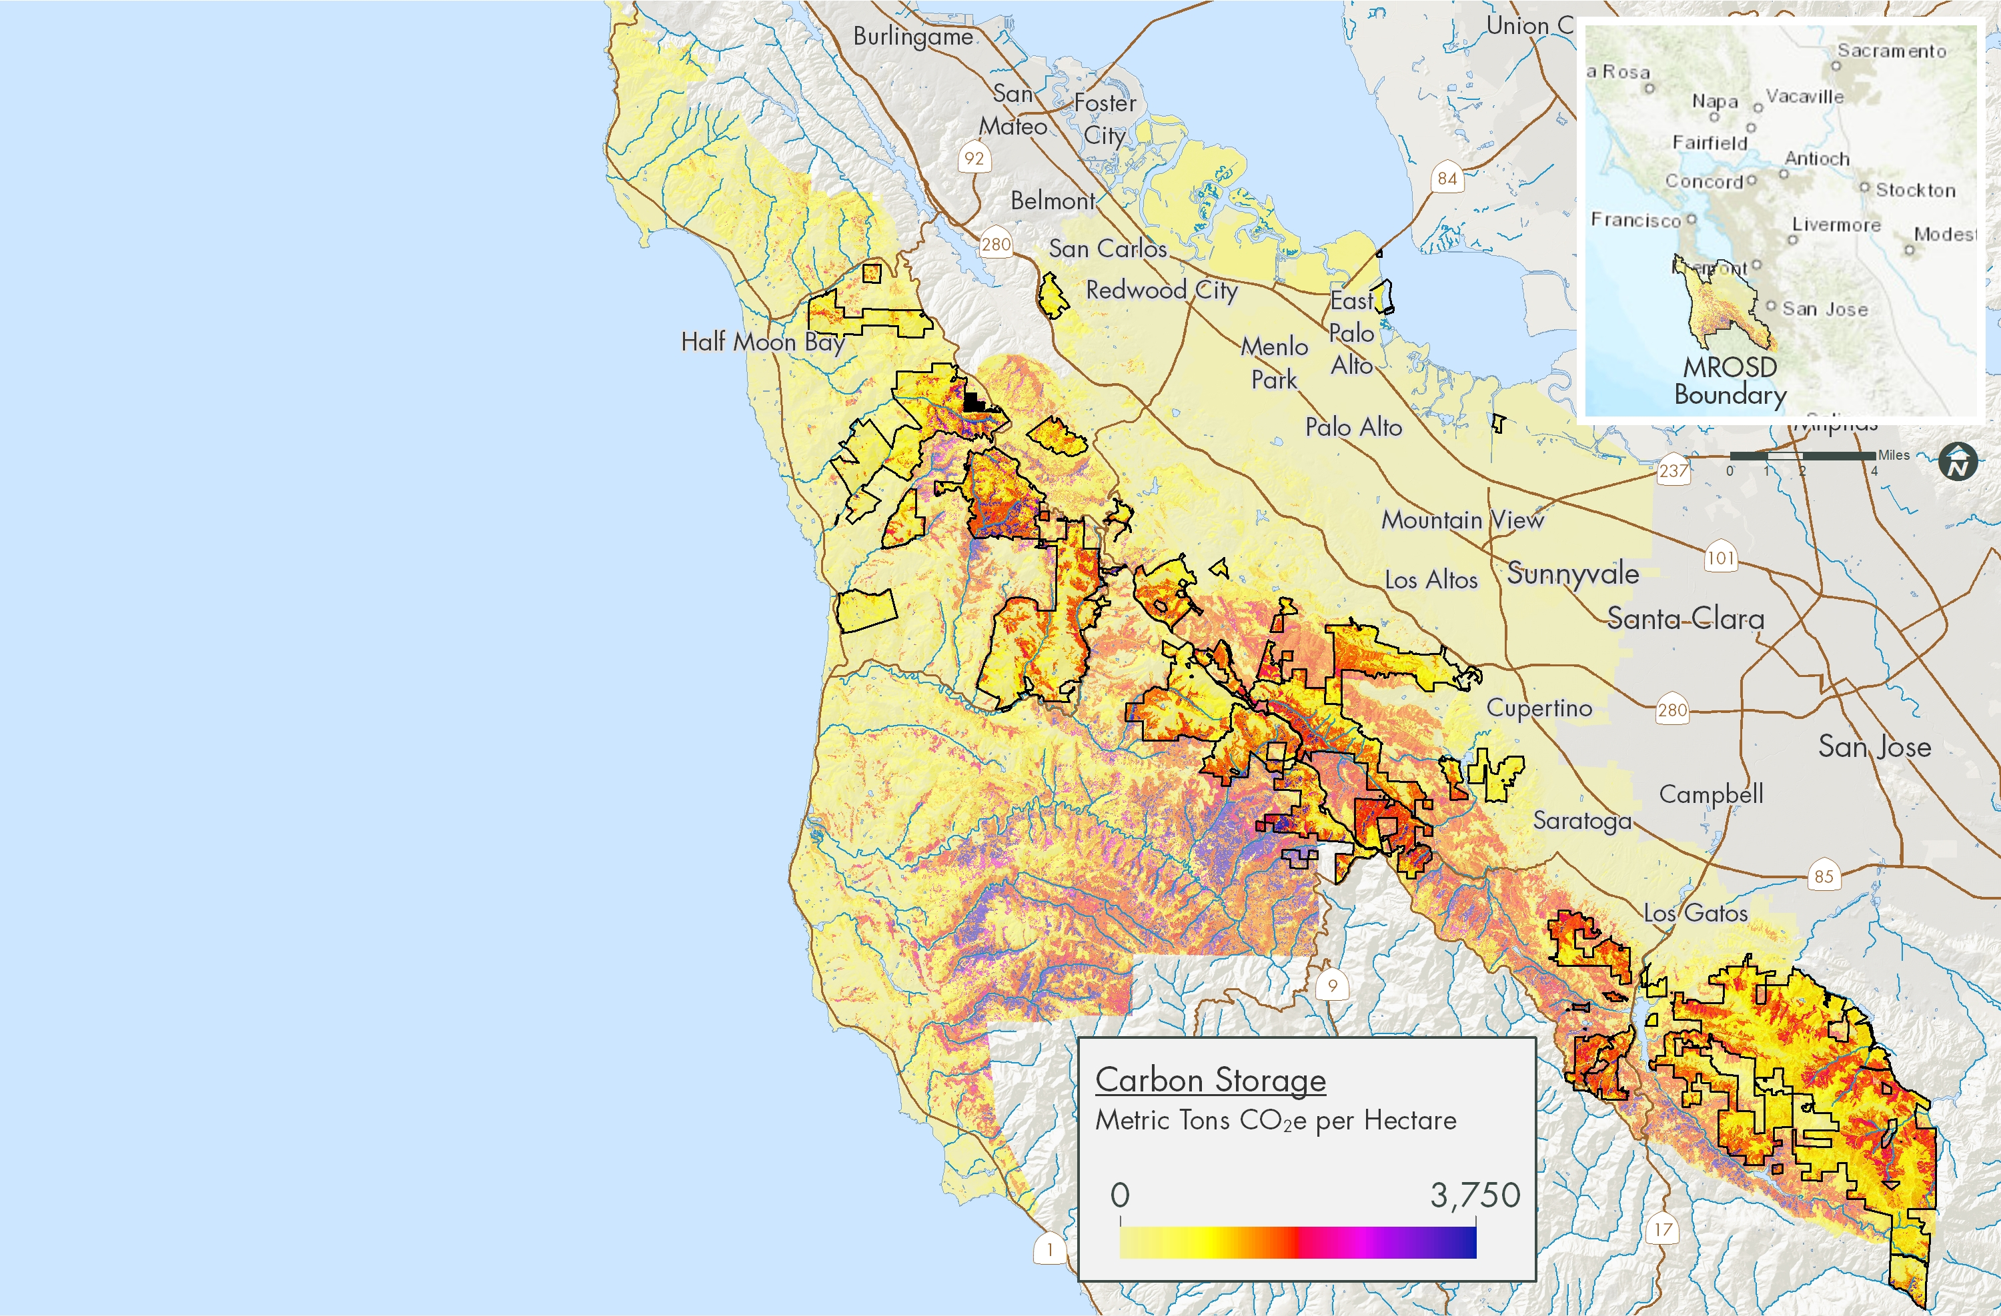
Carbon Storage Assessment
Presentation Outline
Permanent Carbon Storage:
22.8 million MTCO2e
Equivalent to emissions of 5 million cars for one year
Think of as avoided emissions

Slide 10
Carbon Sequestration vs. Operational Emissions
Presentation Outline

Slide 11
Mitigation: Greenhouse Gas Inventory
Presentation Outline

Slide 12
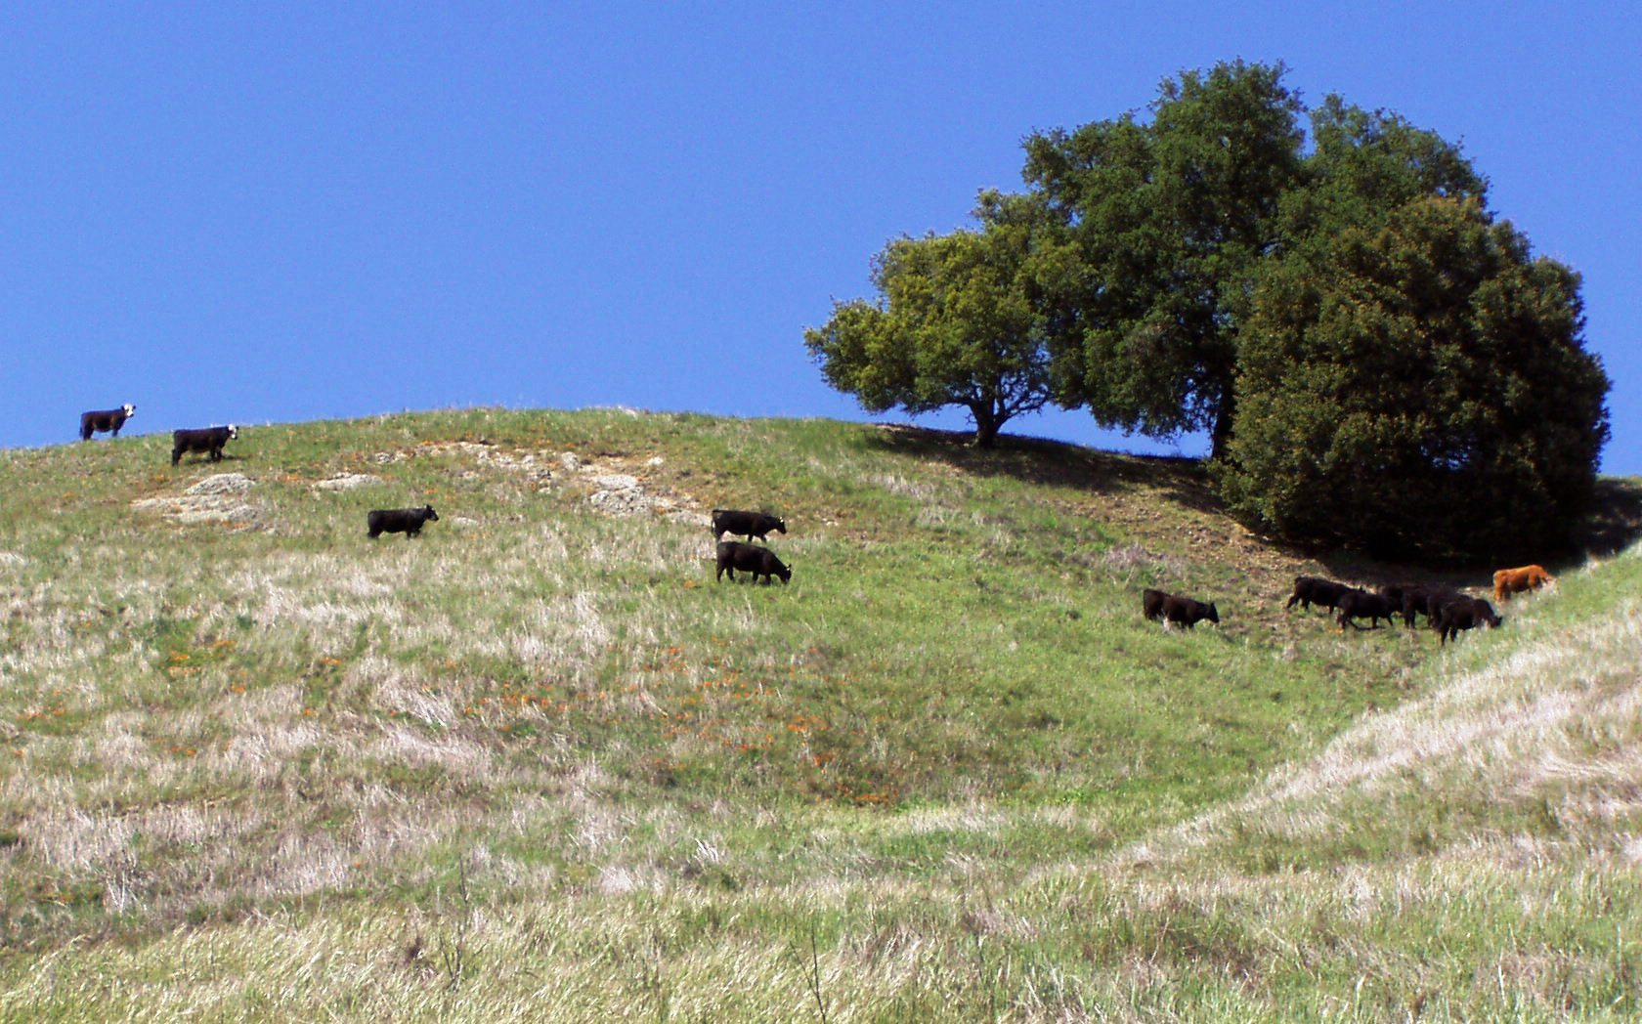
Mitigation: Greenhouse Gas Inventory
Presentation Outline
Livestock
262 Mature cows
82 Heifers/steers
89 Calves

Slide 13
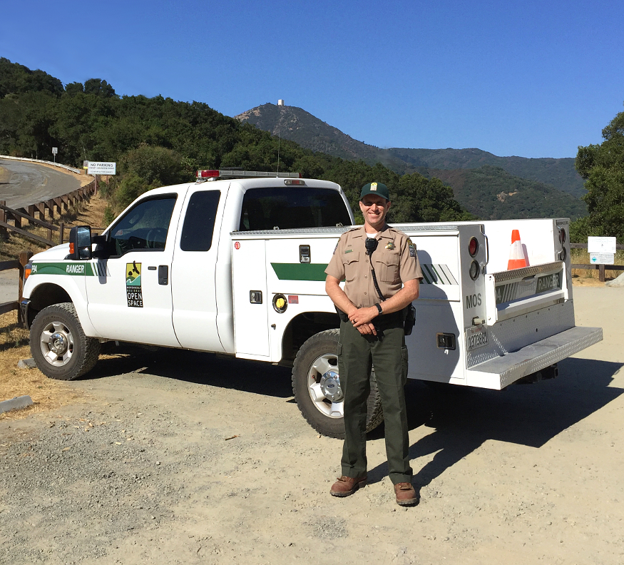
Mitigation: Greenhouse Gas Inventory
Presentation Outline
Vehicles/Equipment
45,000 Gallons of gas
12,000 Gallons of diesel
63 Pickup trucks, 6 commercial trucks, 13 SUVs, 4 hybrids

Slide 14
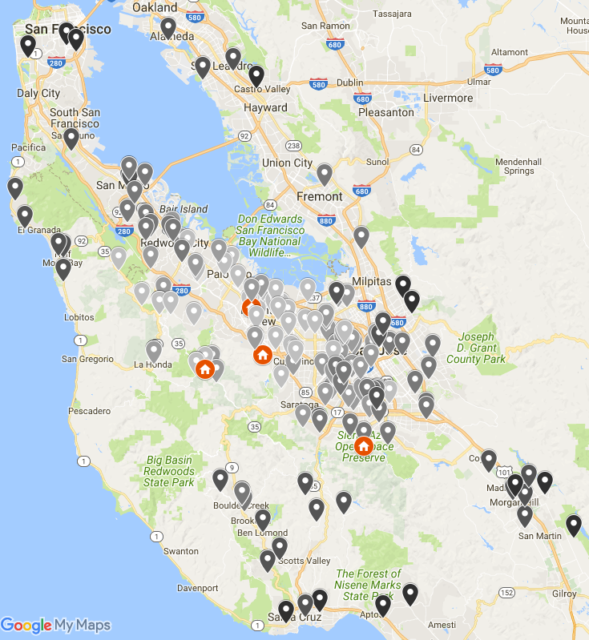
Mitigation: Greenhouse Gas Inventory
Presentation Outline
Employee Commute
Annual commute miles: 1.4 million
Average daily commute (RT): 37 miles; 1.6 hours
Employees who drive to work alone: 83%
Employees who would like to use alternative commute options more often: 46%

Slide 15
Mitigation: Greenhouse Gas Inventory
Presentation Outline
 | EMISSIONS BY SECTOR (MTCO2e/year) |  |  |  |  | MTCO2e PER ACRE
 | Vehicles | Facilities | Commute | Livestock | Visitor Transp | Vehicles & Facilities | Total
Midpen | 588 | 371 | 565 | 876 | - | 0.02 | 0.04
Point Reyes NS | 964 | 656 | - | 12,533 | 6,086 | 0.02 | 0.31
Golden Gate NRA | 749 | 1,382 | - | - | 32,435 | 0.03 | 0.42
East Bay Parks | 2,737 |  | - | - | - | 0.02 | 0.02
Presidio Trust | 1,245 | 2,480 | 687 | - | - | 2.50 | 2.96
To ballpark your organization’s vehicles & facilities GHG emissions:
10,000 acres * 0.02 MTCO2e/acre/year = 157 MTCO2e/year

Slide 16
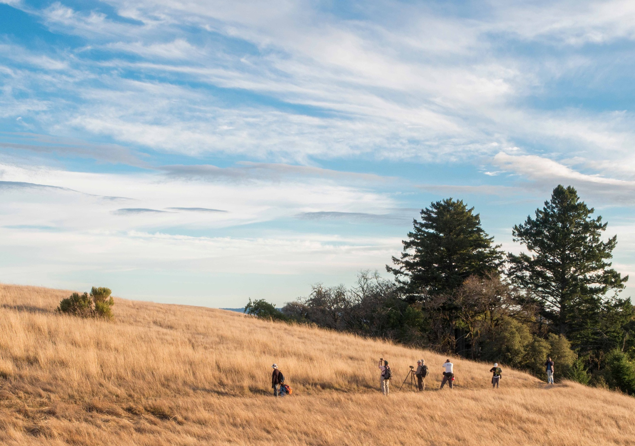
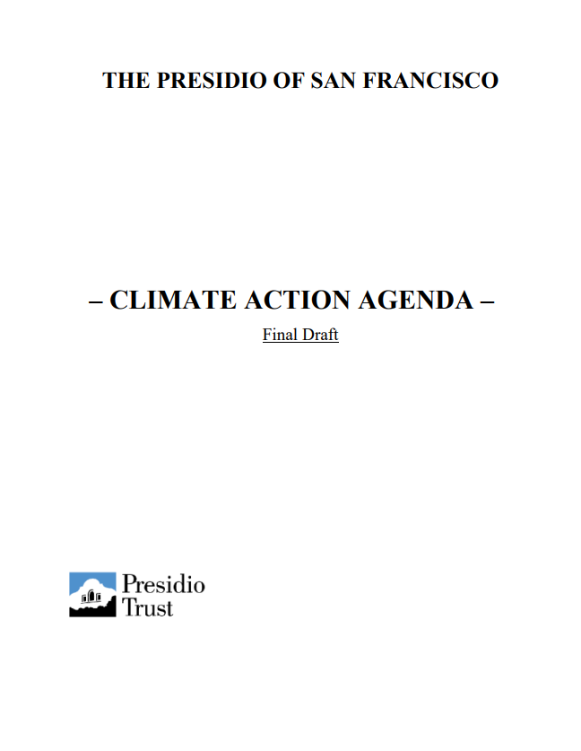
Mitigation: Climate Action Plan
Presentation Outline

Slide 17
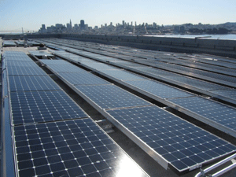
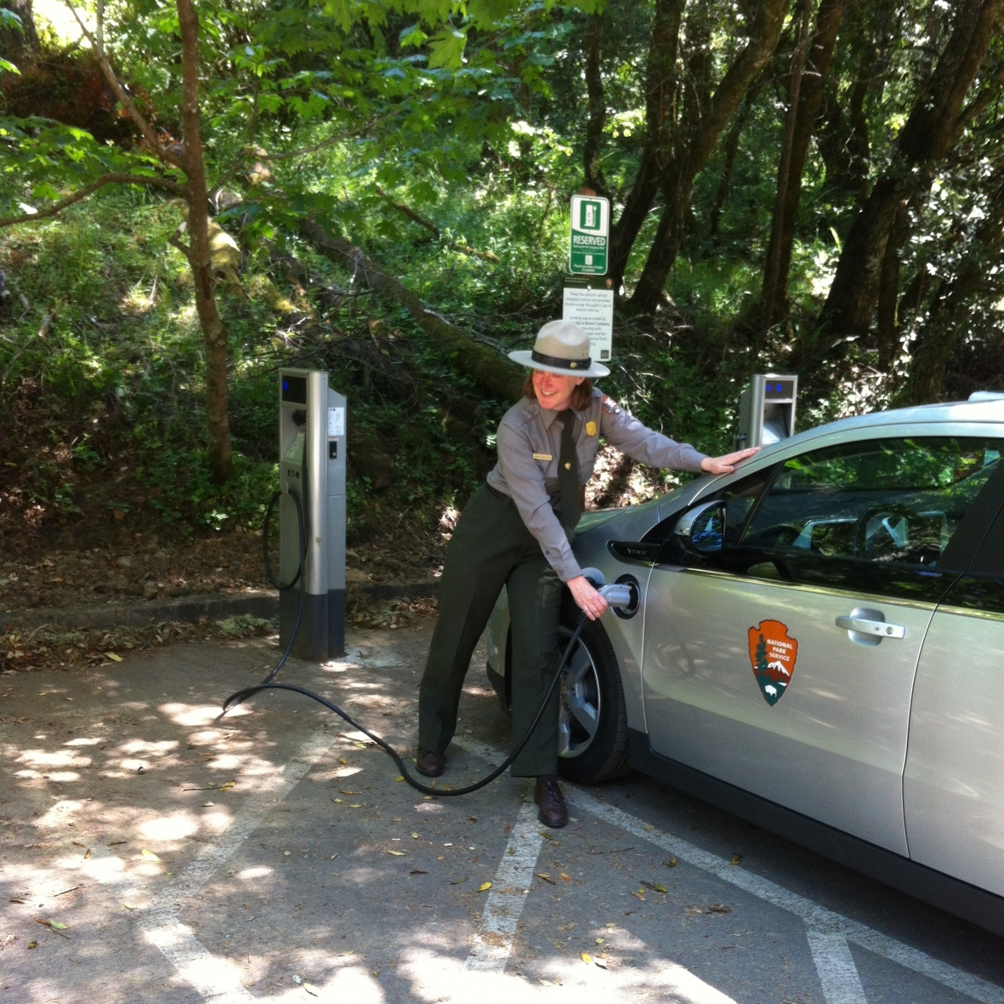
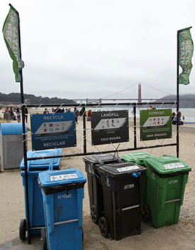
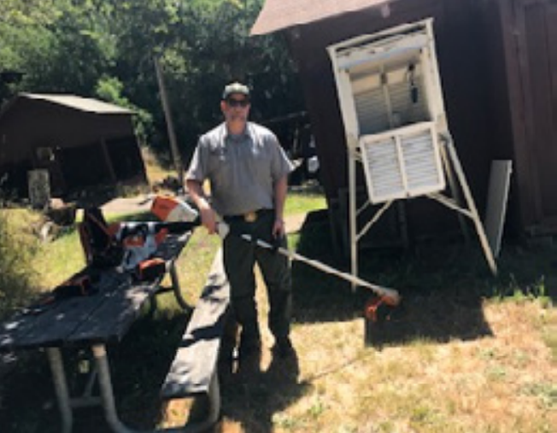
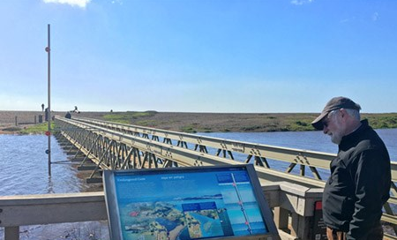
Mitigation: Climate Action Plan
Presentation Outline

Slide 18
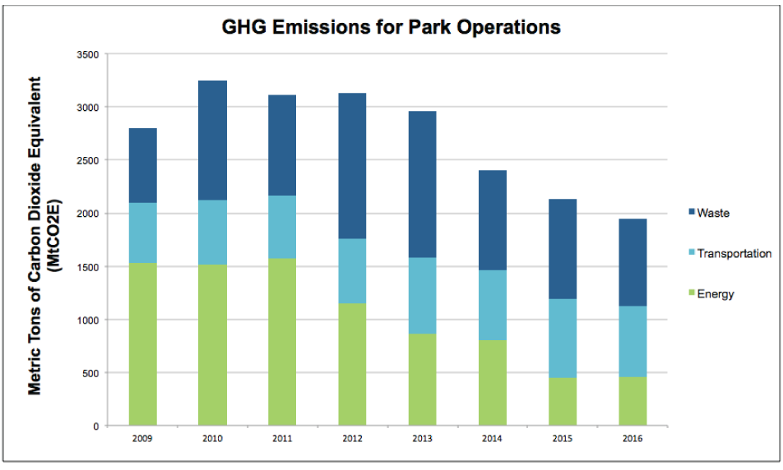
Mitigation: Climate Action Plan
Presentation Outline

Slide 19
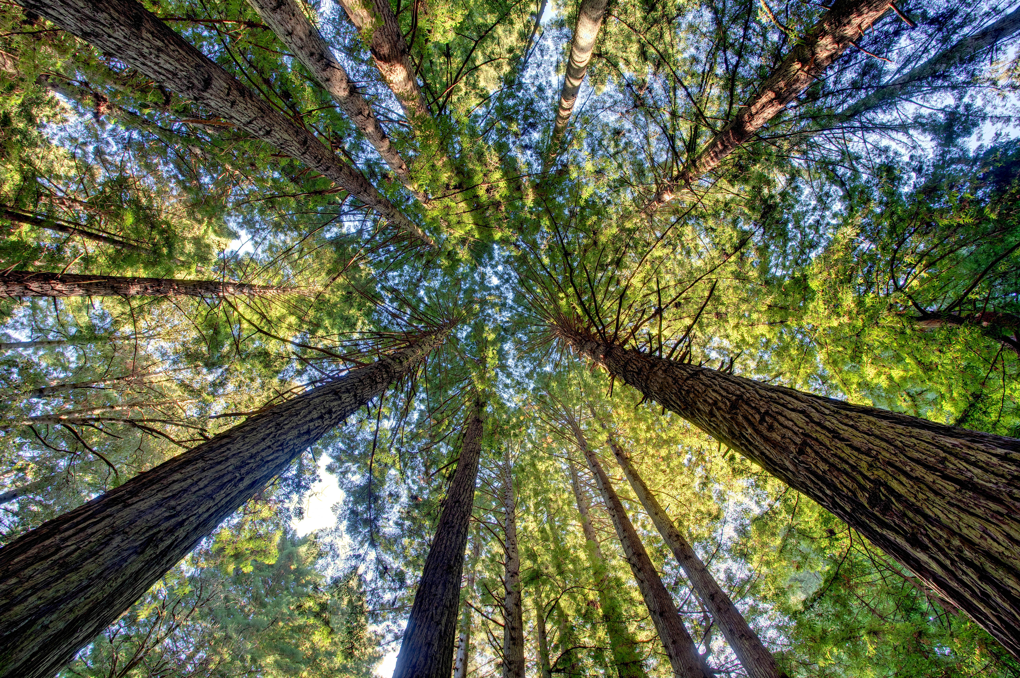
Key Strategies to Reduce Your Organization’s Emissions
Presentation Outline
Employee Commute
Telework option
Compressed work schedule option (e.g. 9 9-hour days per pay period)
Alternative commute incentives/subsidies
Vehicle Fleet
Electric or hybrid vehicles and charging infrastructure
Switch diesel vehicles and equipment to renewable diesel
Reduce miles driven (e.g. phone/video meetings where possible)
Facilities
If served by community choice energy provider, switch to 100% renewable electricity
Explore solar panels and energy efficiency opportunities
Reduce landfill emissions by recycling and composting (offices and parks)
Communicate and model low-carbon choices to the public!

Slide 20
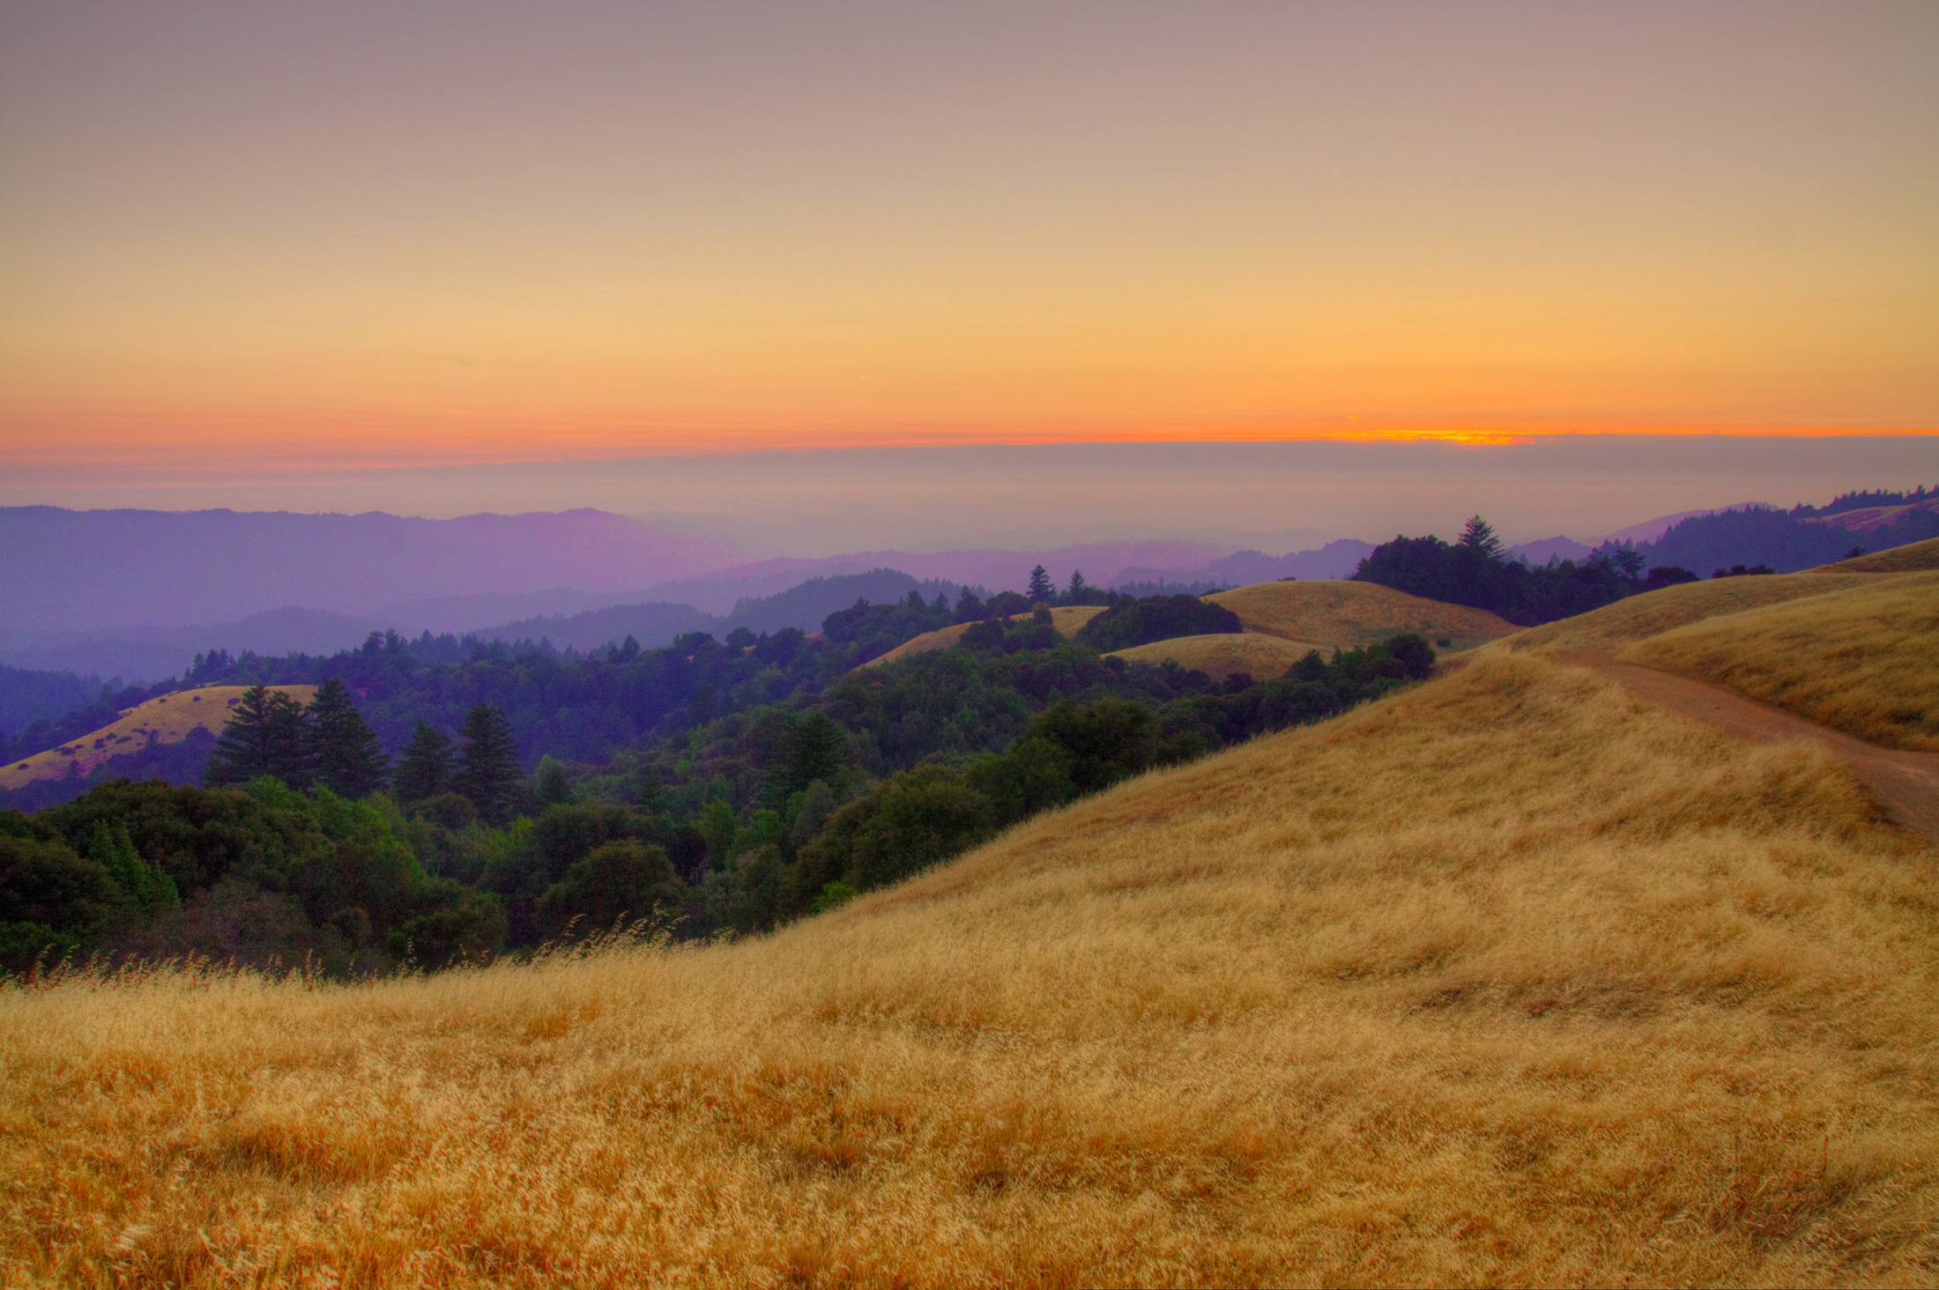
Resources
Presentation Outline
Adaptation/Resilience
CA Landscape Conservation Cooperative: Climate Commons
Cal-Adapt - data on local climate change impacts
CA Natural Resources Agency: Safeguarding California Plan
Carbon Sequestration
Sonoma County/TNC “Climate Action Through Conservation” Report
Bay Area Greenprint
CA Natural and Working Lands Carbon Model (CALAND) - in development
Mitigation (Reducing GHG Emissions)
CA Air Resources Board: Cool California Local Government Toolkit
Statewide Energy Efficiency Collaborative: Resource Library, Learning Portal, and free ClearPath emissions tracking software
ClimateCorps fellowship program

Slide 21
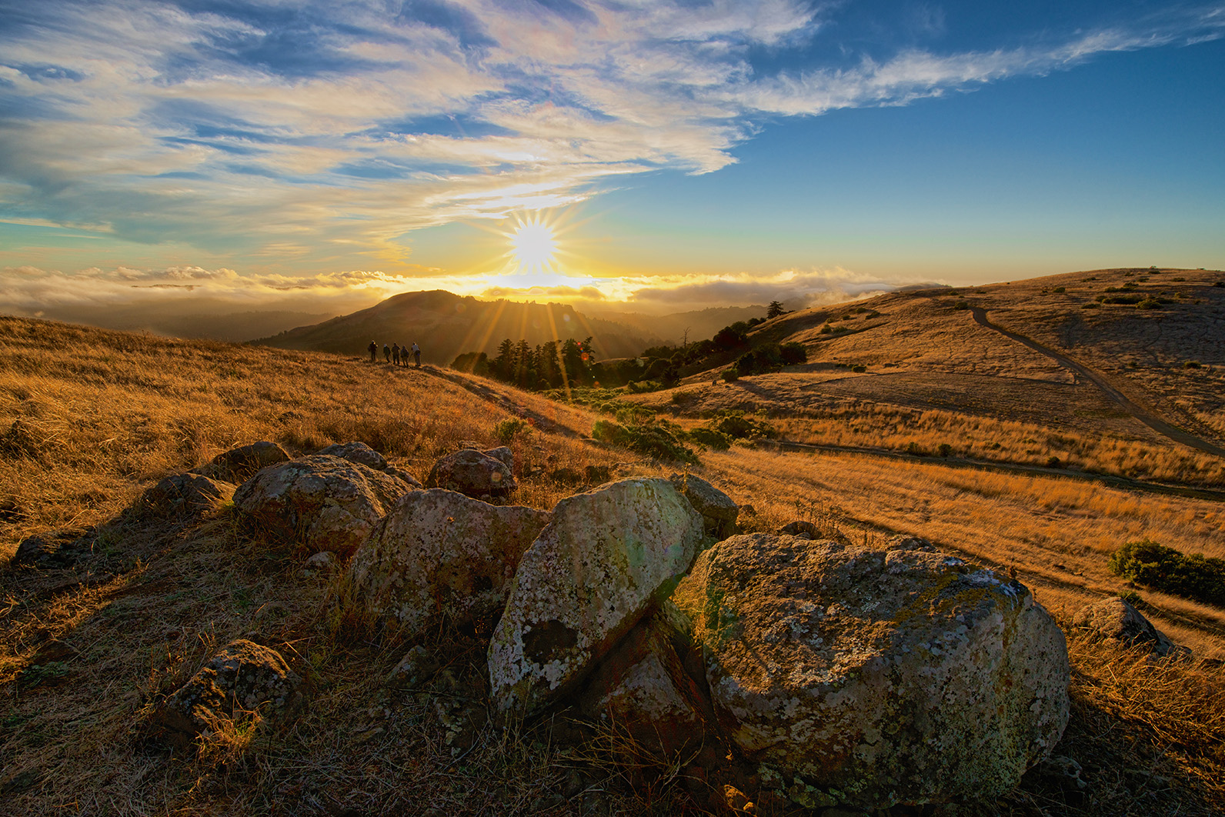
Questions?
Presentation Outline
Kirk Lenington, Natural Resources Manager
klenington@openspace.org
Hayley Edmonston, Climate Resiliency Fellow
hedmonston@openspace.org

